Slide 1
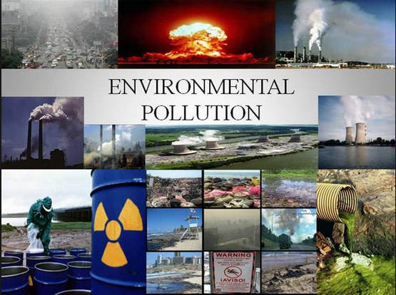

Slide 2
Environmental Pollution
Environmental pollution can be defined as any undesirable change in physical, chemical and biological characteristics of any component of the environment like air, water, soil which can cause harmful effects on various forms of life or property.
Pollution : The term pollution can be defined as the influence of any substance causing nuisance, harmful effects and uneasiness to the environment.
Pollutants : The pollutant may be physical, chemical, bacteriological, suspended, colloidal, dissolved, organic, inorganic, mineral salts, toxic chemicals etc.

Slide 3
Causes of Pollution
Man has spoiled and polluted the environment by:
Uncontrolled growth
Rapid industrialization
Rapid urbanization
Exploitation of nature
Besides man, contributors to pollution are:
Volcanic eruptions
Radio activities
Strong wind
Forest fires
Sand storms etc.

Slide 4
Types of Pollution
Air pollution
Land pollution
Nuclear pollution
Water pollution
Noise pollution

Slide 5
AIR POLLUTION
Air pollution is a chemical, particulate matter, or biological agent that modifies the natural characteristics of the atmosphere.
Air pollution is said to exist if the level of harmful gases, solids or liquids present in the atmosphere are high enough to affect humans, other organisms, buildings, monuments, etc.
Air pollution is measured in terms concentrated suspended particulate matter (SPM), nitrogen-oxide & sulphur dioxide.

Slide 6
Source of Pollutants
Natural sources
sand/dust storms
volcanoes
forest fires
gases produced by decaying organisms
Human activity

Slide 7
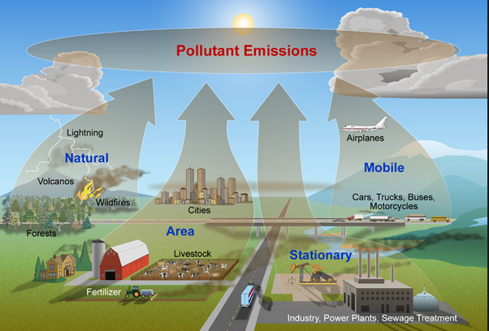

Slide 8
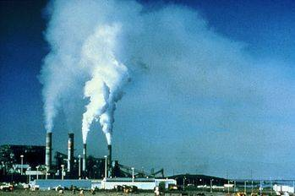
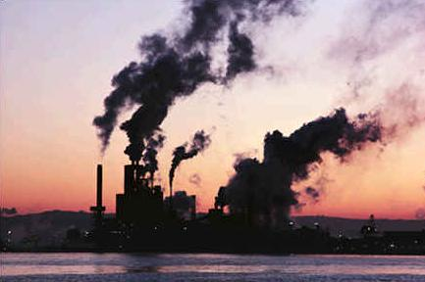
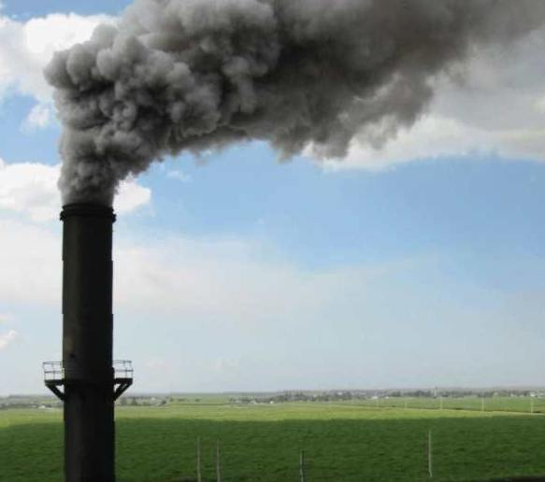
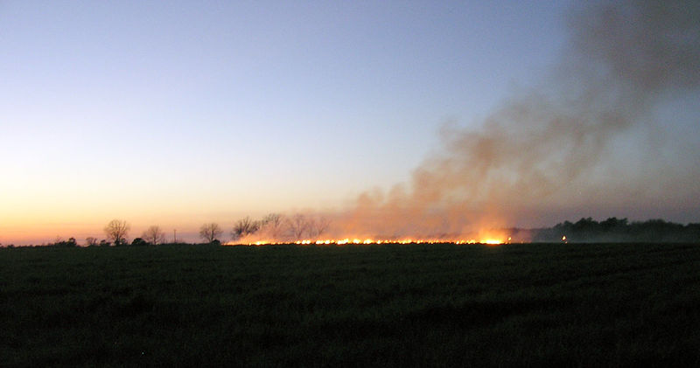
Human Activity
Source : Wikipedia.org

Slide 9
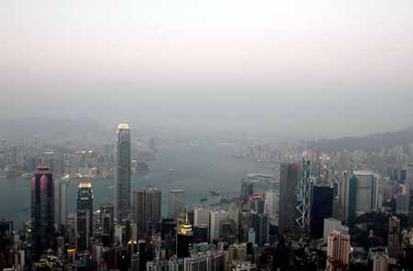
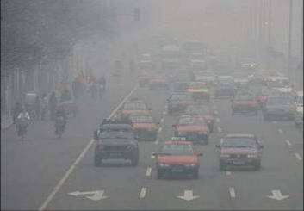
Result: Hazy Horizon
Source : Wikipedia.org

Slide 10
Particulate matter
Solid particles generated by handling, crushing, grinding, spraying and other operations are known as particulate matter.
Particles size vary from 2.5 microns to 100 microns in the atmosphere.
Small and light particles suspend whereas bigger sized particles settle by their own weight.
Fine particles reach human lungs and cause respiratory diseases.

Slide 11
Classification of Pollutants
Primary Pollutant:
Primary pollutants are substances directly emitted from source; such as ash from a volcanic eruption or the carbon monoxide gas from a motor vehicle exhaust.
Secondary Pollutant:
Secondary pollutants not emitted directly. Rather, they form in the air when primary pollutants react or interact. An important example of a secondary pollutant is ground level ozone - one of the many secondary pollutants that make up photochemical smog.

Slide 12
Major Primary Pollutants
Sulfur oxides (SOx) especially sulfur dioxide are emitted from burning of coal and oil.
Nitrogen oxides (NOx) especially nitrogen dioxide are emitted from high temperature combustion. Can be seen as the brown haze dome above or plume downwind of cities.
Carbon monoxide is a product by incomplete combustion of fuel such as natural gas, coal or wood. Vehicular exhaust is a major source of carbon monoxide.
Carbon dioxide (CO₂), emitted from combustion and respiration.

Slide 13
Major Primary Pollutants…..
Particulate matter (PM), measured as smoke and dust.
Volatile organic compounds (VOC), such as hydrocarbon fuel vapors and solvents.
Chlorofluorocarbons (CFCs), harmful to the ozone layer emitted from products currently banned from use.
Ammonia (NH3) emitted from agricultural processes.
Toxic metals, such as lead, cadmium and copper.
Odors, such as from garbage, sewage, and industrial processes
Radioactive pollutants produced by nuclear explosions and war explosives, and natural processes such as radiation.

Slide 14
Secondary pollutants
Particulate matter formed from gaseous primary pollutants and compounds in photochemical smog, such as nitrogen dioxide.
Ground level ozone (O₃) formed from NOx and VOCs.
Peroxyacetyl nitrate (PAN) similarly formed from NOx and VOCs.

Slide 15
Control measures of Air pollution
Using low sulphur coal in industries
Removing NOx during the combustion process
Using mass transportation system
Removing particulate from stack exhaust gases by employing electrostatic precipitator, bag filters, cyclone separators, scrubbers etc.
Shifting to less pollution fuels (Hydrogen gas)
Installing catalytic converters by engine modification to have fuel efficient to reduce CO and hydrocarbon emissions
By planting trees

Slide 16
LAND POLLUTION
Land pollution is the degradation of Earth's land surfaces often caused by human activities and their misuse of land resources.
It occurs when waste is not disposed properly. Disposal of urban and industrial wastes, exploitation of minerals, and improper use of soil by inadequate agricultural practices are a few factors.
Urbanization and industrialization are major causes of land pollution.

Slide 17
Land pollution comprises of :
Solid Waste
Soil Pollution

Slide 18
Solid waste
Wastes from Agriculture: This comprises of waste matter produced by crop, animal manure, and farm residues.
Wastes from Mining: Piles of coal refuse and heaps of slag.
Wastes from Industries: Industrial waste matter that can cause land pollution can include paints, chemicals, and so on.
Solids from Sewage Treatment: Wastes that are left over after sewage has been treated, biomass sludge, and settled solids.
Ashes: The residual matter that remains after solid fuels are burned.
Garbage: This comprises of waste matter from food that are decomposable and other waste matter that are not decomposable such as glass, metal, cloth, plastic, wood, paper, and so on.

Slide 19
Soil pollution
It is caused by the presence of xenobiotic (human-made) chemicals or other alteration in the natural soil environment.
Caused due to :
underground storage tanks,
application of pesticides,
percolation of contaminated surface water to subsurface strata
oil and fuel dumping

Slide 20
Control measures
Use the following guide for each product:
Glass: Bottles or jars can be reused or taken to a bottle bank for recycling. Broken glass can be repeatedly recycled with no reduction in quality, saving energy and raw materials.
Metals: Used aluminum and steel cans can be collected as scrap and smelted for re-use.
Textiles: Old clothes may be given to charity shops or jumble sales or used as rags. Some textiles can be re-used for blankets and cloths.
Vegetable Waste: A bucket with a lid makes a good container for vegetable waste that can be regularly added to the compost heap for use in the garden.

Slide 21
Nuclear pollution
Nuclear waste is the radioactive waste produced by nuclear reactors, or left over from research projects, medical uses, and the manufacture of nuclear weapons.

Slide 22
Nuclear wastes
Two categories
High-level waste (HLW)
Low-level waste (LLW)
These are generally recognized, based on radioactivity, source and hazard.

Slide 23
High Waste
High-level waste consists mainly of spent fuel rods from nuclear reactors.
These power plants rely on nuclear fission to generate heat, and the fuel is made into rods that can be moved in and out of the reactor core to control the process. After a time, the rate of fission in a rod will decrease to the point where it is no longer efficient, and the rod will be removed. The removed rods are known as spent fuel rods and are highly radioactive, containing a number of fission products.
These elements decay at different rates, and over time, the rods become less radioactive, but will remain potentially dangerous for many thousands of years.

Slide 24
Low Level wastes
It comes from a wide variety of sources. It consists of materials that have come into contact with radioactive substances, or which have become radioactive themselves due to exposure to some forms of radiation, as well as small quantities of radioisotopes from research establishments and hospitals.
Examples are items of protective clothing worn by staff who work with radioactive materials, and syringes and needles used for the injection of radioisotopes for medical purposes. It typically remains potentially hazardous for between a few tens and a few hundreds of years.

Slide 25
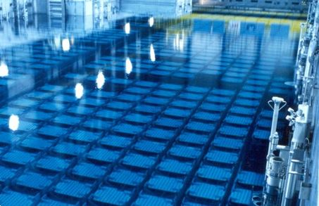
Nuclear fuel storage pool
Source : www.pinterest.com

Slide 26
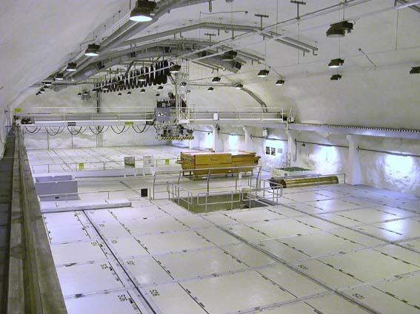
Low-level waste repository in Finland
Source : cienciaensocietat.org

Slide 27
Control of Radioactive Pollution
The following preventive measures should be followed to control radioactive pollution :
Leakage of radioactive materials from nuclear reactors, industries and laboratories using them should be totally stopped.
Radioactive wastes disposal must be safe. They should be changed into harmless form or stored in safe places so that they can decay in a harmless manner. Radioactive wastes only with very low radiation should be discharged into sewerage.
Preventive measures should be taken so that natural radiation level does not rise above the permissible limits.
Safety measures should be taken against accidents in nuclear power plants.

Slide 28
Water Pollution
Water pollution can be defined as alteration in physical, chemical or biological characteristics of water through natural or human activities and making it unsuitable for its designated use.
Water is used for drinking, domestic, agricultural, irrigation, industries, navigation and recreation.

Slide 29
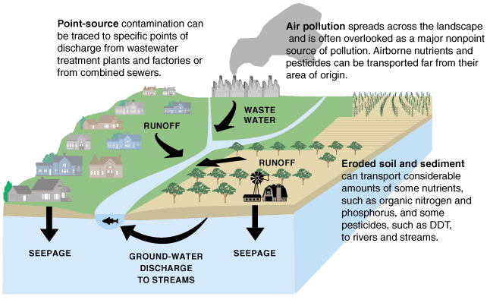

Slide 30
Sources of water pollution are :
Municipal waste water
Industrial waste
Inorganic pollutants
Organic pollutants
Agricultural wastes
Marine pollution
Thermal pollution

Slide 31
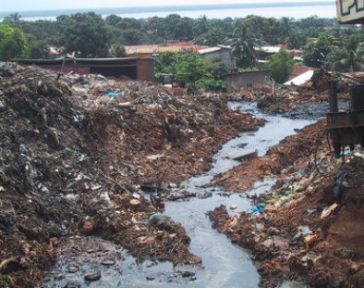
Municipal wastewater
Municipal wastewater is defined as wastewater from households or a mixture of wastewater from households and of industrial origin as well as precipitation water.
It is comparatively easy to almost completely break down these pollutants with the help of micro organisms used in wastewater treatment plants.

Slide 32
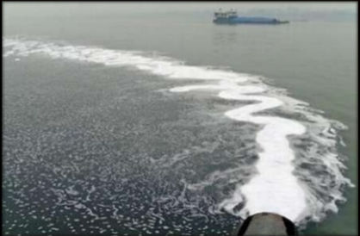
Industrial waste water
The major source of water pollution is the waste water discharged from industries such as chemical, metallurgical, food processing industries, textile, paper industries.
They discharge several organic and inorganic pollutants that prove to be highly toxic.

Slide 33
Inorganic pollutants
They include fine particles of different metals, chlorides, sulphates, oxides of iron, cadmium, acids and alkalies.
Organic pollutants
They include fats, oils, phenols, organic acids, grease and several other organic compounds

Slide 34
Agricultural wastes
Chemical fertilizers and pesticides have become essential for the present day high yielding crops.
Consequently they have become a potential source of water pollution.
They contain major plant nutrients such as nitrogen, phosphorous and potassium.
Excess fertilizers may reach the ground water by leaching or may be mixed with surface waters of rivers, lakes and ponds by runoff and drainage.

Slide 35
Marine Pollution
Oceans are the final sink of all natural and manmade pollutants.
Rivers discharge their pollutants into the sea.
The sewage and garbage of the coastal cities are also dumped into the sea.
The others sources include discharge of oil, grease, plastics, detergents and radioactive wastes from ships.

Slide 36
Marine Pollution Abatement
Identify load & type of pollutants and cut it at the source.
Political commitment and enforce legislation.
Coastal and marine planning & management.
Create less waste.
Reduce/Eliminate the creation of pollutants through increased efficiency in the use of raw materials, energy, water etc.
Pretreatment before disposal to sea.
Use of equipment to reduce water content and volume in the chemical process.

Slide 37
Thermal Pollution
Thermal pollution is the degradation of water quality by any process that changes ambient water temperature.
A common cause of thermal pollution is the use of water as a coolant by power plants and industrial manufacturers. When water used as a coolant is returned to the natural environment at a higher temperature, the change in temperature decreases oxygen supply and affects ecosystem composition.
Fish and other organisms adapted to particular temperature range can be killed by an abrupt change in water temperature (either a rapid increase or decrease) known as "thermal shock."

Slide 38
Effects of Water Pollution
It damages the food chain. The toxins from water travel to the body of human and animals.
The water pollution is responsible for spreading some deadly diseases like cholera, typhoid, diarrhea, and other communicable diseases. This is called microbial water pollution and the pathogens are responsible for it.
Polluted water can also adversely affect the human heart and kidneys. The toxins in the human body can create problems like poor blood circulation, vomiting, skin lesions, damage to nervous system and others.

Slide 39
Ground water level gets contaminated by carcinogenic elements like lead, cadmium and others which when consumed with drinking water increases the risk of having cancer.
Acid rain is another worry to water pollution. Sulfate particles present in water creates problem for marine life. It pollutes the water and also affects the food chain of marine life.
Lots of pollutants in water can be responsible for changing the acidity, temperature, and conductivity of water.

Slide 40
How to prevent water pollution?
Educating the public about its harmful effects to human and environment.
Enforcing stringent environmental laws.
Do not dispose household chemicals to the sink or to the toilets.
Avoid over dosage of pesticides and fertilizers.
Don’t throw any non degradable substances to rivers, lakes and oceans.
Pretreatment of industrial waste water before discharging to water bodies.

Slide 41
Noise pollution
Noise pollution is the disturbing or excessive noise that may harm the activity or balance of human or animal life.
The source of most outdoor noise worldwide is mainly caused by machines and transportation systems, motor vehicles, aircraft and trains.
Indoor noise can be caused by machines, building activities, and music performances, especially in some workplaces. There is no great difference whether noise-induced hearing loss is brought about by outside (e.g. trains) or inside (e.g. music) noise.

Slide 42
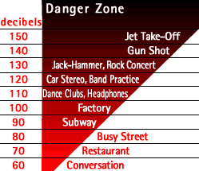
Noise levels

Slide 43
Causes
Transportation sector:- aircrafts, trains, trucks, tractors, cars, three-wheelers, motorcycles etc. contribute maximum noise.
Industrial & construction machinery:-factory equipments, generators, pile-drivers, pneumatic drills, road rollers etc. make lot of noise.
Special events :- high volume sound speakers during festivals , marriage celebrations, public meetings etc. create unbearable noise.

Slide 44
Effects of noise
Noise is generally harmful and can create serious health hazard.
Noise can lead to physiological & psychological damage if the volume is very high or the exposure is prolonged.
Vibrations of high pitches create permanent hearing impairment.
Noise can also have other ill effects like heart problem, pupil dilation or muscle contraction.
Migraine headache, nausea, dizziness, gastric ulcers and constriction of blood vessels are some of the other possible bad effects of noise.

Slide 45
Noise control measures
Producing less noise is the best method of reducing type of pollution. All machinery should be so designed that the noise produced is minimum.
All the persons working in noisy areas should wear noise shield like ear-plugs and such areas should be isolated by having noise absorbing materials.
Proper lubrication and better maintenance of machines will reduce noise while running.
By using:
silencers to control noise from automobiles, ducts, exhausts etc. noise levels can be reduced;
glass wool or mineral wool covered with a sheet of perforated metal plates , mechanical vibration isolation can be partly achieved.

